Slide 1
Welcome to Open House!
Your child will receive a free HW pass tomorrow for your attendance, so make sure you’ve signed in!

Slide 2
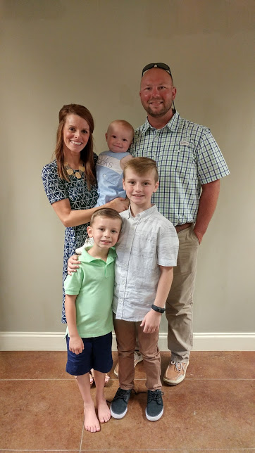
Mrs. Arthur
jarthur1@tipton-county.com
My husband, Clint and I have been married for seven years. We have three boys, Caden is in 4th grade, Bo Banks is beginning his kindergarten year, and Brooks is my toddling one year old.
My undergraduate degree is in Elementary Education from The University of Memphis.
This will be my fifth year teaching 5th grade at Atoka Elementary.

Slide 3
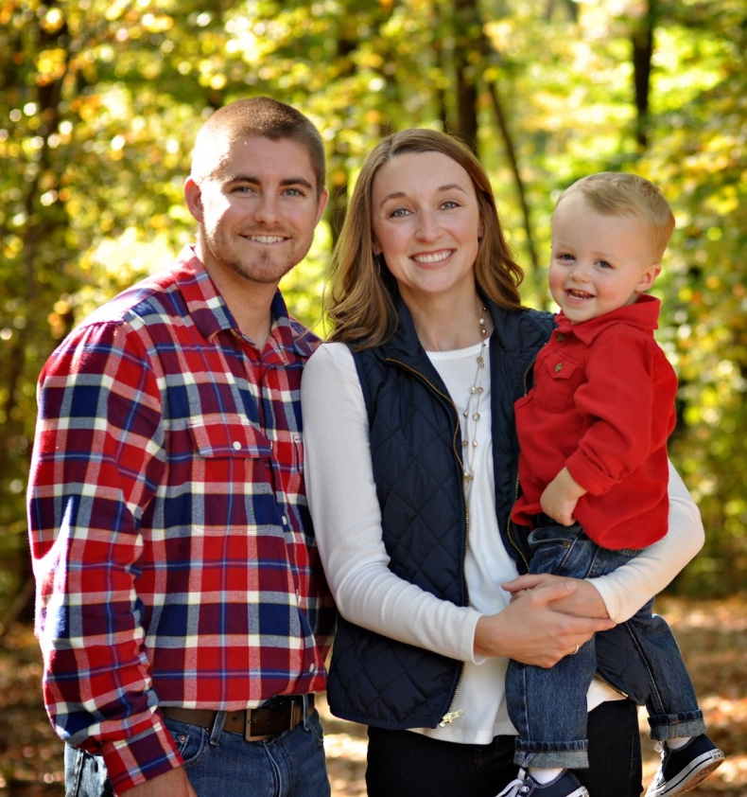
Mrs. Dawson
sdawson@tipton-county.com
I have been married to my husband, Hunter, for almost 6 years. Our son, Drew, will be
3 in December.
I received my Bachelor’s Degree from Middle Tennessee State University.
This is my seventh year teaching 5th grade!

Slide 4
Reading
TN Ready and Coach books are Common Core aligned.
Every week your student will read a set of stories matching our skill, and then test on the skill Friday. We use our composition notebooks to record each skill we learn. These can be used as notes to help study at home.
Each week we introduce a new Greek and Latin root. These words serve as our Spelling and Vocabulary words. Use the weekly journal entry as their study guide for the test on Friday.
*Students will need to know not only the spelling of the word, but also the meaning and application.*
Homework should be completed and turned in on
the due date. Homework will be recorded in the agenda.

Slide 5
Accelerated Reader
AR is monitored throughout the 9 weeks.
If the student has earned an 80% or above on comprehension average, they are rewarded incentives.
We use Easy CBM throughout the year to monitor your student’s learning.
Fall-Winter-Spring
A.R. will begin after every student
has been able to test on the
Easy CBM.

Slide 6
English
TN Ready Book is Common Core aligned.
Every week in English we will use our composition notebooks to record our new skills. This is a great study tool to use at home!
We focus a lot in 5th grade on usage and not so much identification. At this point, students should know the basics of grammar. We focus on using it correctly in our writing. The curriculum is no longer based on, “can you find the verb?”
We spend much of our time editing and incorporating new grammar skills in our writing.

Slide 7
Writing
Get ready to write everyday!
Write Bright is a powerful writing curriculum we use to teach high quality writing techniques. Students in every grade level are taught the same writing plan.
We keep our writing in our “Writers’ Notebook.” Students will be assessed on the writing plan throughout the nine weeks.
*Parents, there will always be a plan outline in their notebook for you to look at with your child. *

Slide 8
Math
TN State Standards
5th Grade Curriculum:
Operations & Algebraic Thinking
Number & Operations in Base Ten
Number & Operations in Fractions
Measurement & Data
Geometry
FLUENCY: Multiplying multi-digit numbers

Slide 9
Math
We will use the textbook but won’t always go in order of the book.
Math Journals are the greatest study tool. These include lesson notes, examples, and strategies from class.
Homework will provide extra opportunities for students to practice what is learned in
class. We will review homework at the
beginning of class each day.

Slide 10
Math Grades
Daily Grades – “Quick Checks”
There is no set day of the week for tests. Test dates will be sent home in the weekly newsletter and your child should write it in his/her agenda.
Graded Multiplication Quizzes will be given every Friday. These will be timed and will increase in difficulty as the year progresses.
Practicing at home is the BEST way to prepare for these!
Math Station Participation Grade
Extra Credit opportunities will be provided each 9 weeks, but it will be up to the student to get the information, complete it, and turn it in on time.

Slide 11
Social Studies & Science
Alternating every two weeks.
The notebooks will be your greatest study tool!
Requires reading comprehension and text evidence.
Social Studies: Pre-Civil War to Current Times
Science: Various concepts of
life, earth, and physical sciences.
Extra Credit

Slide 12
“Need to Knows”
Binders: Organization is extremely important!
Front Pocket: Things to be completed and returned to school.
Back Pocket: Items you may keep at home. This is where graded papers will be placed each Wednesday. Please remove the papers to keep and sign the Graded Paper Log in the back of the binder.

Slide 13
“Need to Knows”
Agendas :Homework & important notes and reminders will be written in agendas daily. If your child has had a conduct issue that day, it will also be noted. No news is good news! ☺ Please read and sign your child’s agenda nightly.
It is also the responsibility of each student to record their homework
in his/her agenda each day.
Treats: If you would like to send treats to school for birthdays or special occasions, please make sure they are store bought and individually wrapped.
ATES discourages cupcakes for birthdays due to allergy issues. Instead, we encourage ice-cream to be bought from the cafeteria for the class.

Slide 14
“Need to Knows”
Homework: Homework is an essential tool in your child’s academic success. He or she is expected to complete his/her homework as it is assigned. Failure to do so will result in a TRACK point.
Conduct Grades:
S- (1 Point) N (2 points) U (3 points)
11 or more TRACK points = N on report card
21 or more TRACK points = U on report card
The student will not be able to participate in the TRACK Event.
New Schoolwide Behavior Rules:
Be Ready
Be Respectful
Be Responsible

Slide 15
“Need to Knows”
Transportation: If you ever have a change in your child’s transportation, you must send a note to be verified through the front office. Please send notes on a separate piece of paper.
All transportation notes, excuses for absences, and money should be placed in your child’s binder in the “Priority Pocket”.
Lunch Prices:
breakfast prices
students full paid $1.00
visitors $1.25
lunch prices
students full paid $2.25
visitors $3.00
*Thanksgiving meal for all adults $5.00*

Slide 16
Want to Help at Home?
Visit our website and visit the “Educational Resources” page to find websites and other information for practice and ways to help.
Website: www.arthurdawson.weebly.com
This slideshow will also be
uploaded to our webpage.

Slide 17
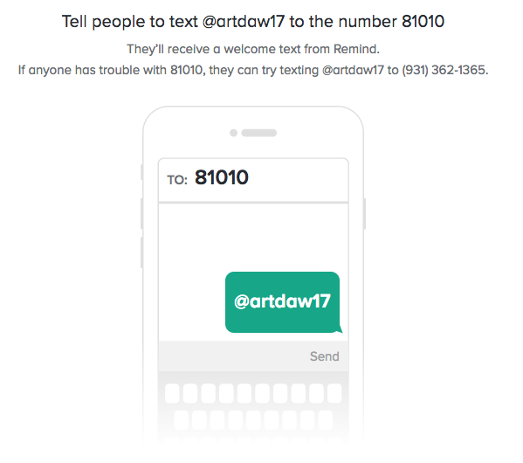
Sign up for our Remind Messages!
If you would like to donate to our classrooms, please take a “Helping Hand” from the cart in the hallway! Thanks! ☺

